Slide 1

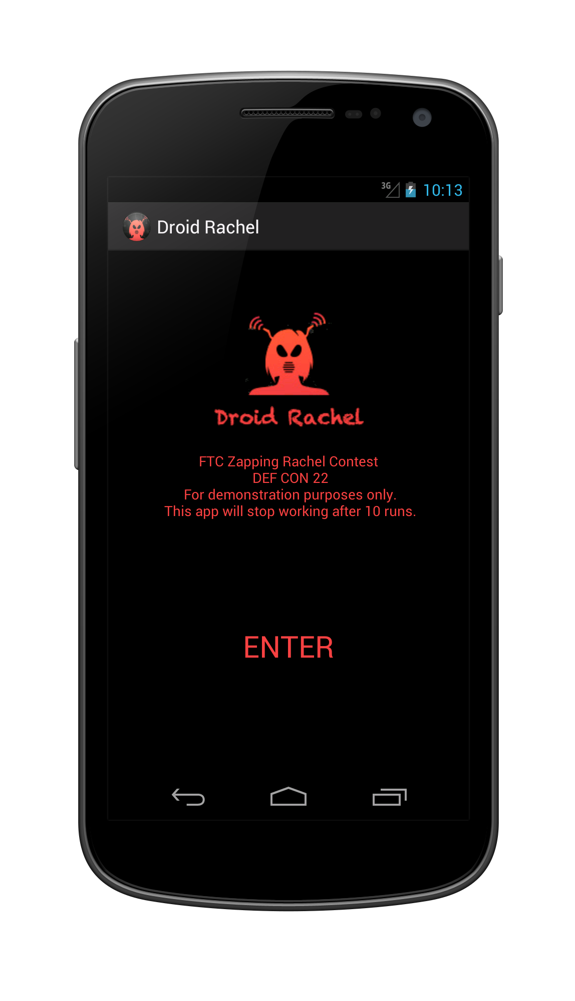
FTC ZAPPING RACHEL ROBOCALL CONTEST
- PHASE 2 “ATTACKER”
“Droid Rachel”
Android based Smart-Dialer
bypassing FTC’s Robocall honeypot
Key Features:
Multi-Level validation of target numbers:
  CARRIER Check; avoids numbers not managed by Verizon or At&t
  CNAME Check; avoids numbers with placeholder (city/state) record
  TYPE Check; prefers wireless numbers for higher response rates
  AREA CODE Check; Dialing device matching area code of target
Outbound via active cell phone lines instead of less trusted VoIP
Distributed attack to avoid traffic based detection/shutdown
Dynamic configuration to run as Robocall or/and SMS campaign
Fetches target #’s + campaign assets (audio, strings) from CC server
“Droid Rachel” skipped 25 of 25 numbers provided in this contest.

Slide 2
“DROID RACHEL”
- CONT.
High Level Architecture:
Android Application performing all steps of target validation
  Application can be visible (as demonstrated) or hidden (Trojan)
  Background campaign execution during business hours, when device not unused
  Optional: Malicious application could self propagate using on-device contacts
Command and Control Server for feeding/harvesting target and campaign data
  Optional: Self feed target numbers by using on-device contacts
API accounts for target validation:
  NUMBERCOP # Validator API http://numbercop.com/api/
  Data 24x7 Carrier Type API http://www.data24-7.com/
Call back # + IVR system matching outbound campaign theme
  Twilio, TelAPI, etc.

